Slide 1
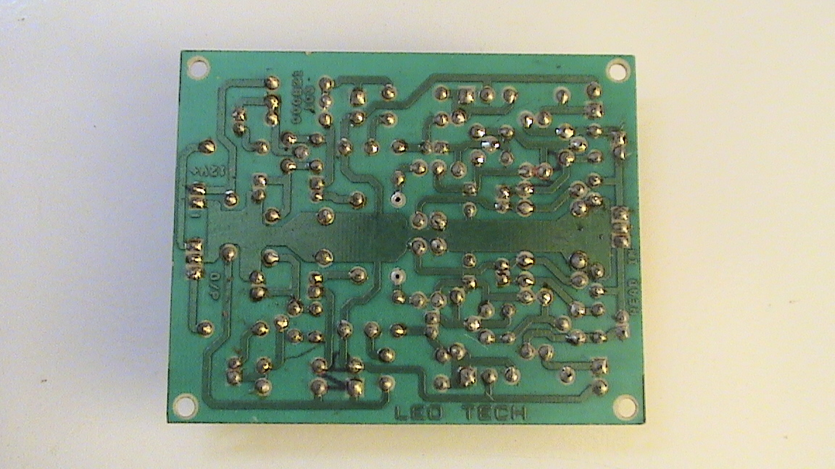
PCB
PRINTED CIRCUIT BOARD
DRAW BACKS OF TAG BOARD / GROUP BOARD /BREAD BOARD OVER A PCB
COMPLEXITY MORE
2) MORE SPACE REQUIREMENTS
3) MORE COST
NO PERMENENT CONNECTIONS

Slide 2
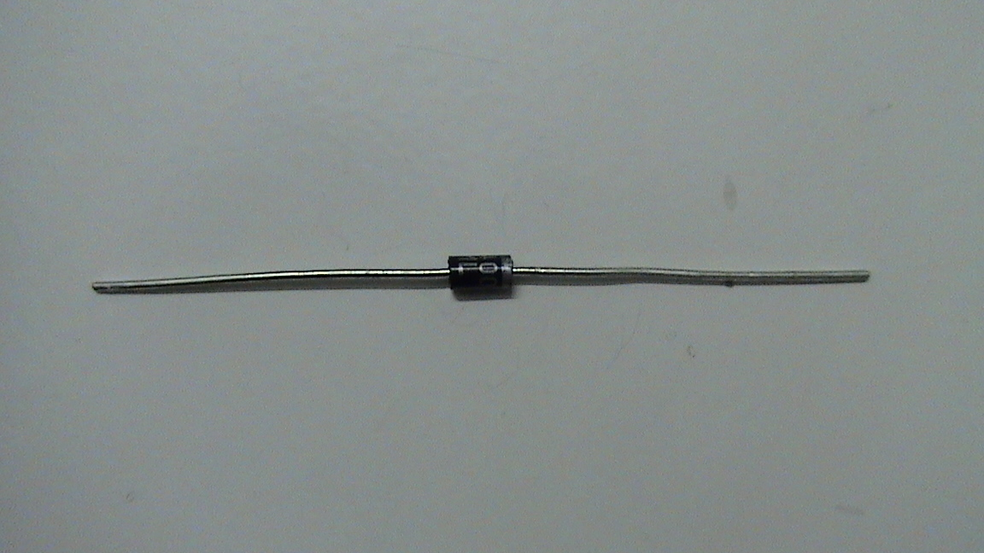
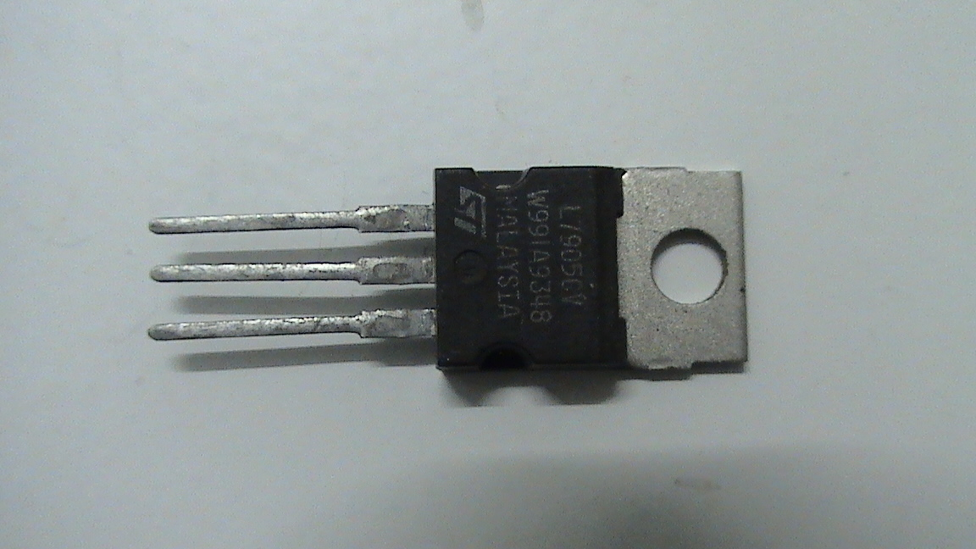
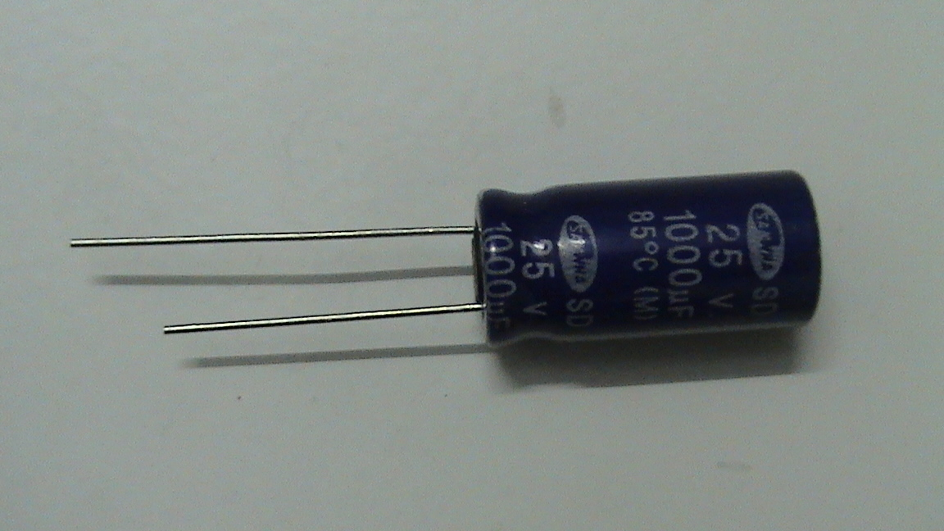
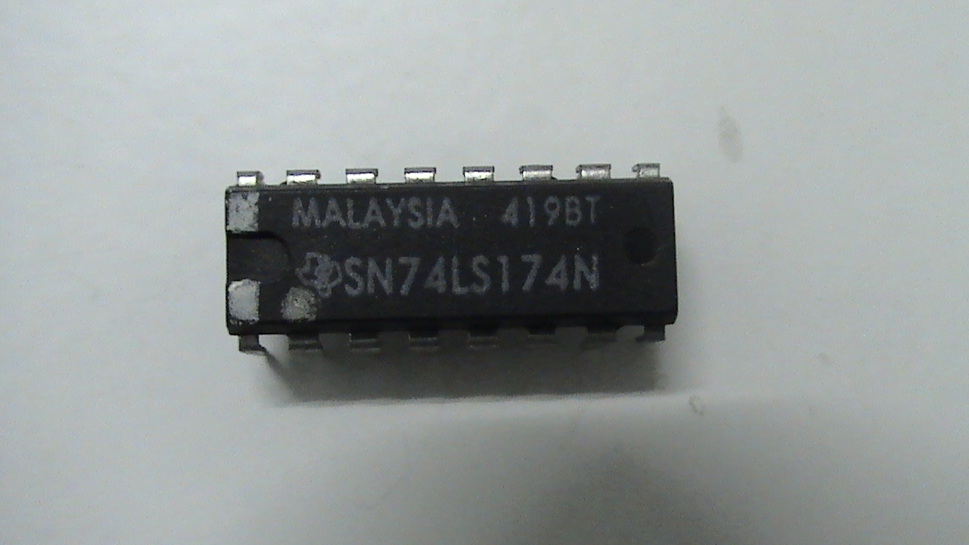
COMPONENT DIMENSIONS
EACH COMPONENT IS HAVING ITS OWN DIMENSION SYSYTEM
FOR EX -- RESISITOR FOR ITS HORIZONTAL MOUNTING 1CM BETWEEN THE PADS .
CAPACITOR ARROUND 0.5CM TO 5CM AS PER THE VALUE .
DIP IC BETWEEN THE PINS 0.6 TO 0.8MM.
DIODE ARROUND 1CM.
AND THIS IS INTERNATIONAL SYSYTEM OF STANDARD DIMENSIION

Slide 3
DESIGNING STEPS
1)DESIGN THE LAYOUT USING SOFTWARE.
2)REPRINT THE LAYOUTUSING SCREEN PRINTING.
3)PRINT IT ON PLAIN COPPER CLAD WTH
PERMNENT INK.
4)ETCH THE PCB USING FECL3 SOL.
5)REMOVE THE INK USING ACETONE.
6)DRILL AND MOUNT THE COMPONENT.

Slide 4
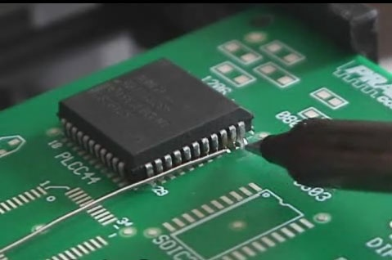
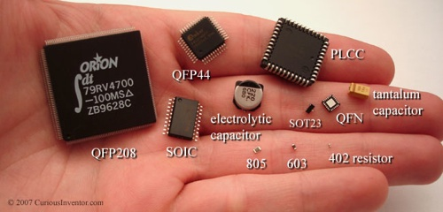
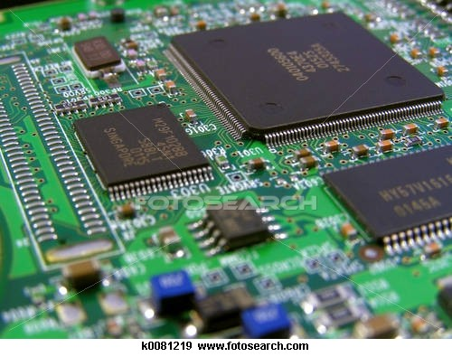

TYPES OF ICS

Slide 5
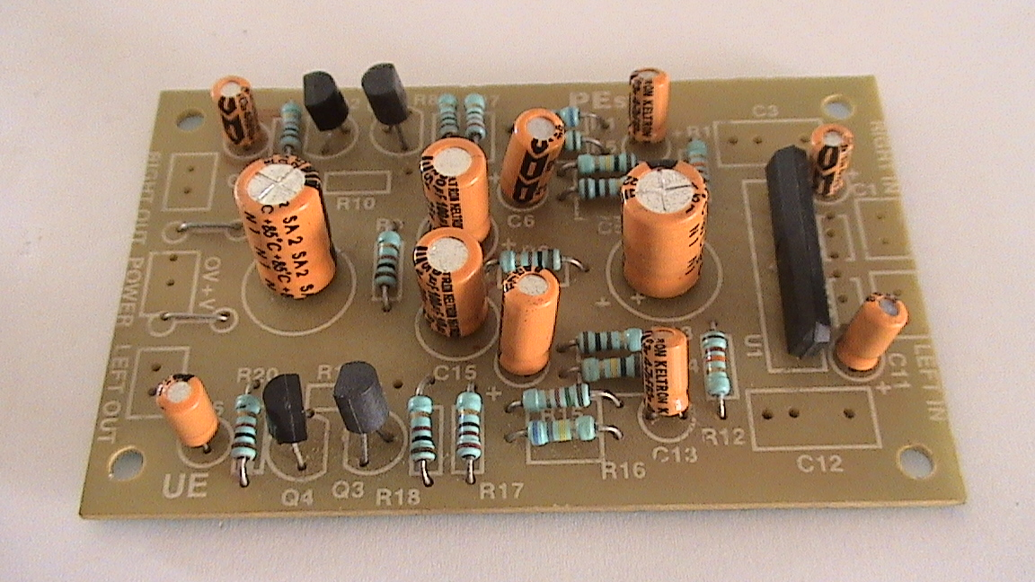
COMPONENTS LAYOUT

Slide 6
PCB LAYOUT

Slide 7
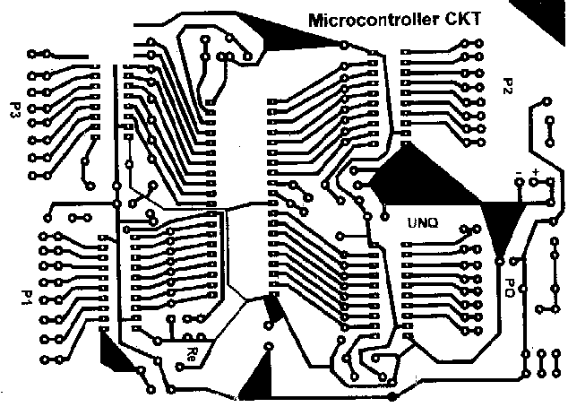
PCB LAYOUT
PCB PRINT OUT WITH SOFTWARE

